Slide 1
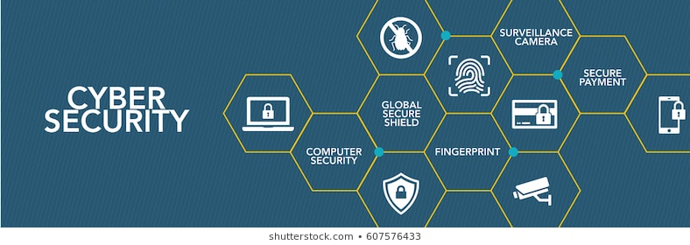
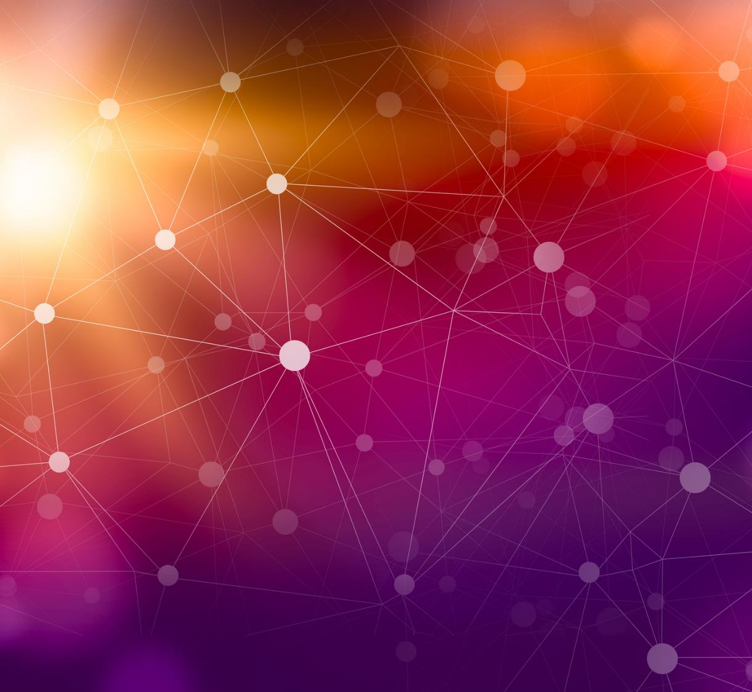
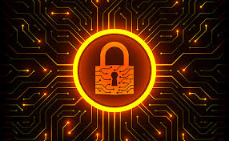
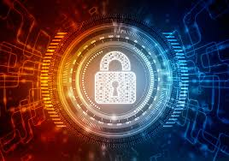
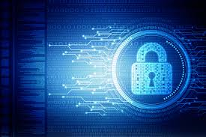
Information /Cyber Security Awareness
Shiv Kumar

Slide 2



Agenda
Why Cyber/Information important
Introduction of cyber security
Types of Cyber crime
Safety tips to Cyber crime
Online shopping Safety tips
Tips for social media security

Slide 3
Why Cyber/Information Security important Cybersecurity statistics indicate that there are 2,200 cyber attacks per day, with a cyber attack happening every 39 seconds on average. In the US, a data breach costs an average of $9.44M, and cybercrime is predicted to cost $8 trillion by 2023. Statista Market Report's revenue in the Cybersecurity market is projected to reach $162 billion in 2023. It is expected to show an annual growth rate from 2023 to 2028 of 9.63%, resulting in a market volume of $256.50 billion by 2028.
Every 39 seconds there is a hacker attack.
Healthcare remains the top target of ransomware attacks.
92% of malware was delivered via email.
4.1 million websites have malware at any given time.
49 days is the average time it took to identify a ransomware attack.
$29M was stolen from a fintech company by a hacker.
97% of all security breaches exploit WordPress plugins.
$3 billion worth of cryptocurrency was stolen in hacks till now.

Slide 4
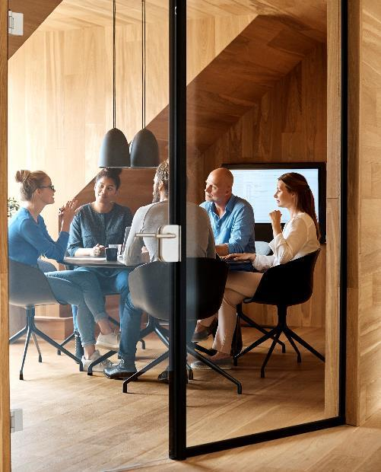
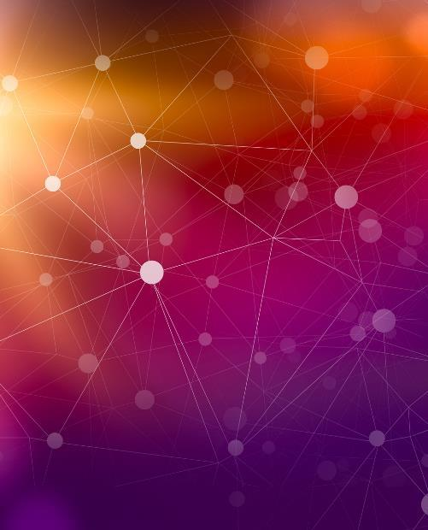

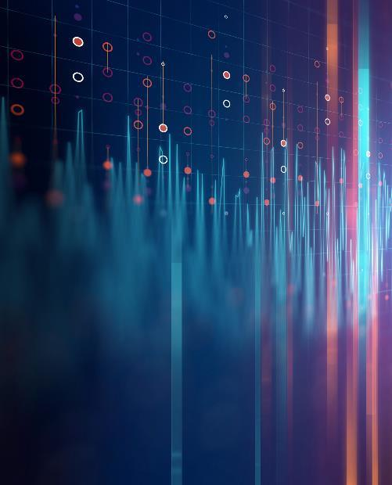
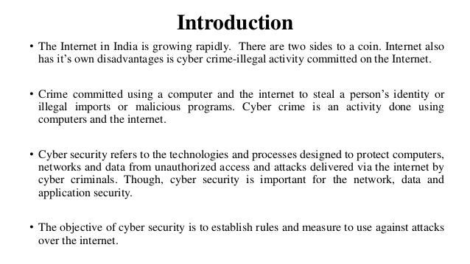
Introduction of Cyber Security
With PowerPoint, you can create presentations and share your work with others, wherever they are. Type the text you want here to get started. You can also add images, art, and videos on this template. Save to OneDrive and access your presentations from your computer, tablet, or phone.

Slide 5
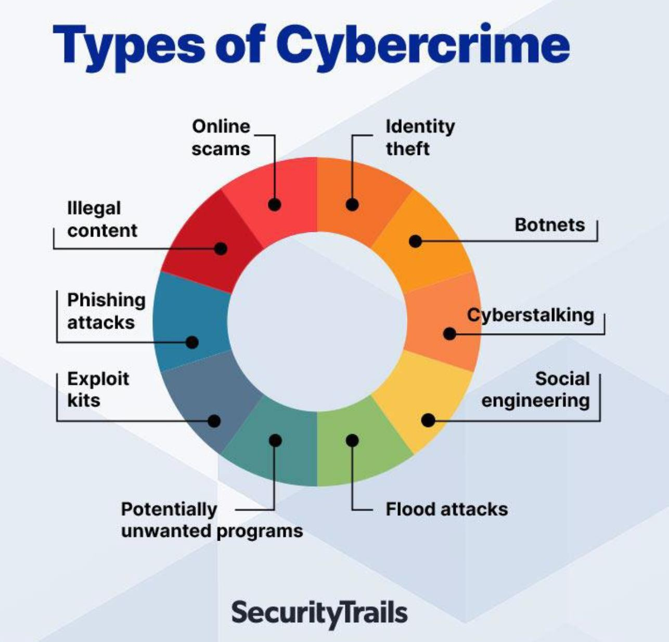
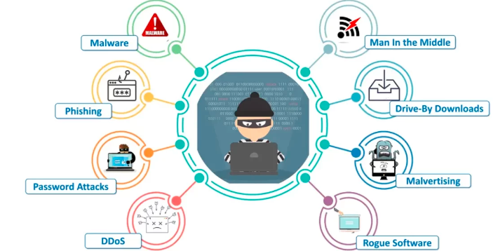
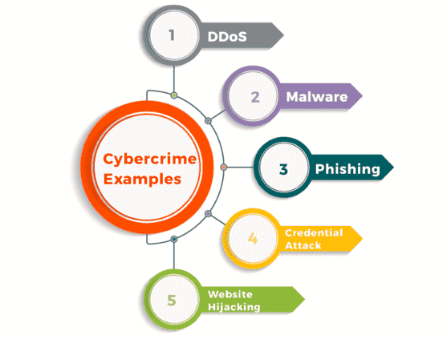

Slide 6
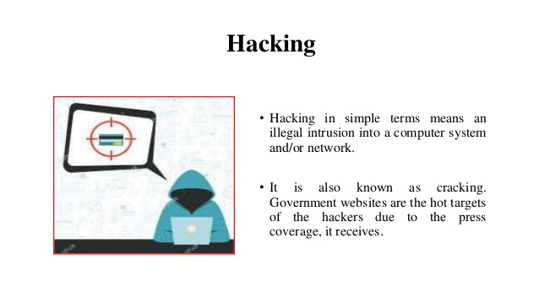
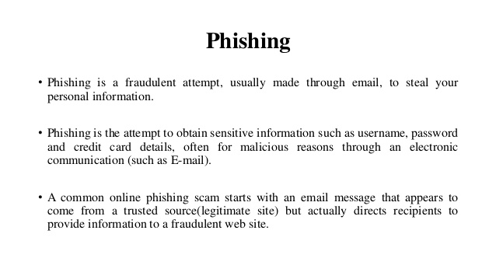
Table
 | Category 1 | Category 2 | Category 3 | Category 4
Item 1 | 4.5 | 2.3 | 1.7 | 5
Item 2 | 3.2 | 5.1 | 4.4 | 3
Item 3 | 2.1 | 1.7 | 2.5 | 2.8
Item 4 | 4.5 | 2.2 | 1.7 | 7

Slide 7
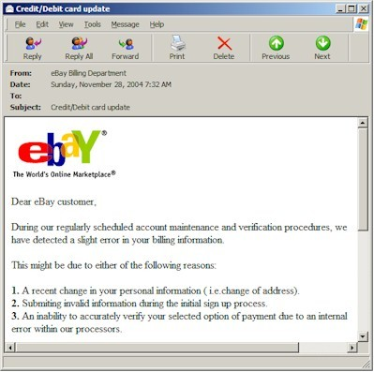
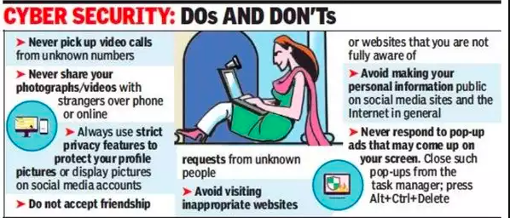
Phishing: Counterfeit Email
Phishing: A seemingly trustworthy entity asks for sensitive information such as SSN, credit card numbers, login IDs or passwords via e-mail.
Simple Brute Force Attacks. A simple brute force attack occurs when a hacker attempts to guess a user's login credentials manually without using any software. This is typically through standard password combinations or personal identification number (PIN) codes.
Notes:
Phishing: A type of Social Engineering. The use of e-mails that appear to originate from a trusted source to trick a user into entering valid credentials at a counterfeit website. Typically the e-mail and the web site looks like they are part of a trusted organization with whom the user is familiar.

Slide 8
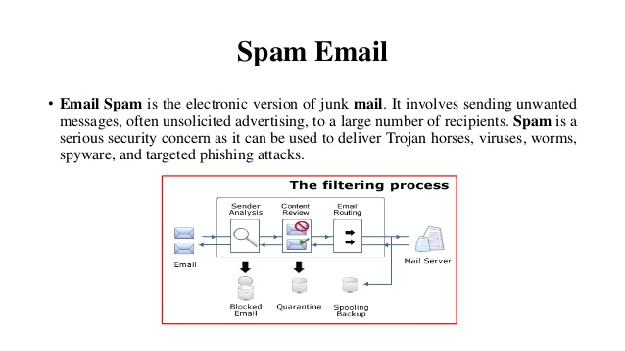
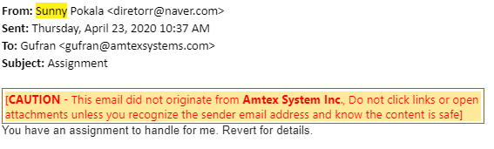
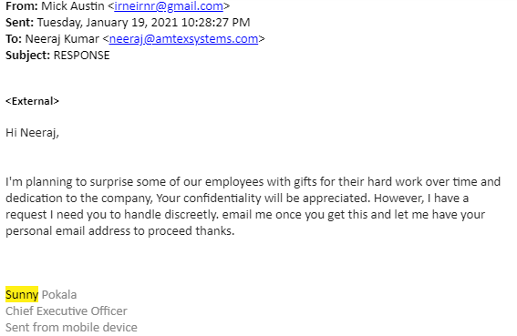

Slide 9
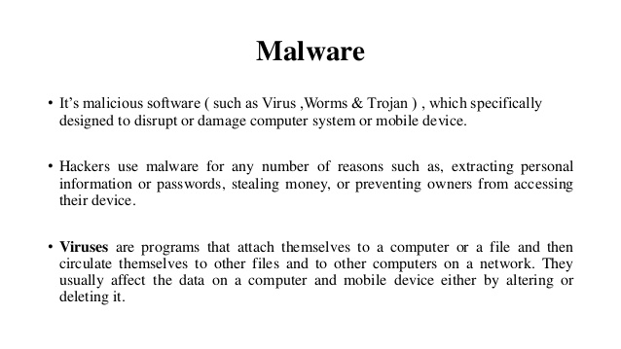

Slide 10
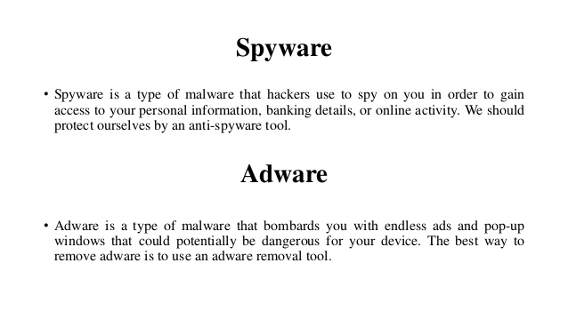

Slide 11
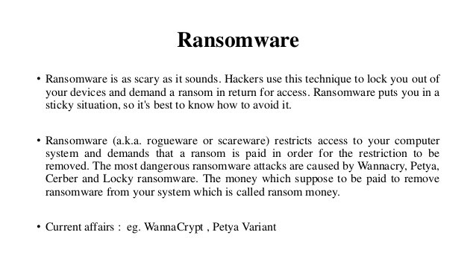
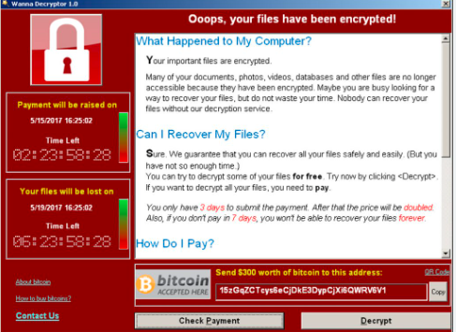

Slide 12
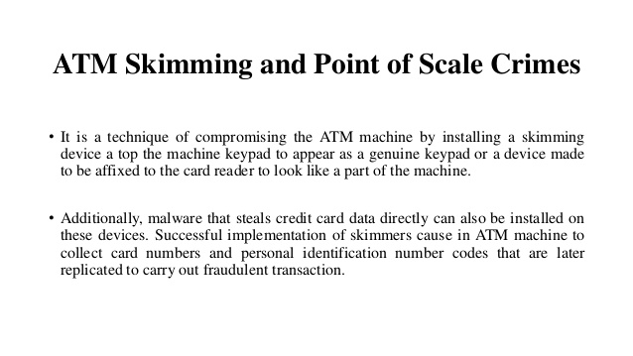
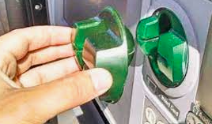

Slide 13
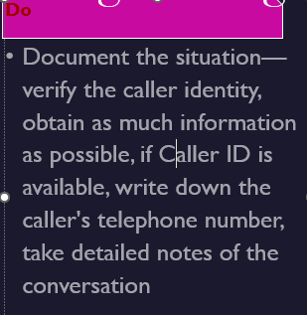

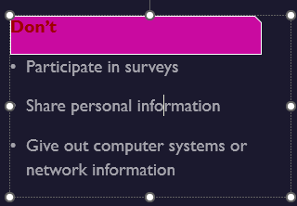
Social Engineering
Hello, I'm calling from Technology for America – we're a non-profit organization, working to help ensure that the U.S. stays at the forefront of computer technology.
Today we're conducting a telephone survey about the usage of computer systems. Can I ask you a few questions about your computer system?
Social engineering is a collection of techniques intended to trick people into divulging private information. Includes calls emails, web sites, text messages, interviews, etc.
Notes:
Even with the best passwords and encryption, we are still left with the issue of social engineering. Social engineering is a collection of techniques intended to trick people into divulging private information. The social engineer attempts to use the information to gain unauthorized access to computer systems, or to commit fraud.
Social engineers use a variety of communication devices to contact their victims, including:
Telephone surveys,
E-mail messages,
Websites,
Text messaging,
Automated phone calls, and
In-person interviews
The intention of social engineering is to steal your identity (identity theft), run up bills or commit crimes in your name, or access your organization's computer systems. Phishing is a serious, high-tech scam.
Social engineering can also happen to us at work—bad actors trying to break into Department systems.

Slide 14
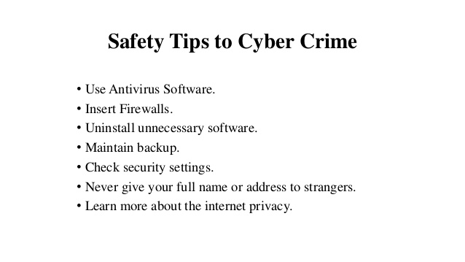
Content
Subtitle
Subtitle
Add text, images, art, and videos.
Add transitions, animations, and motion.
Save to OneDrive, to get to your presentations from your computer, tablet, or phone.
Open the Design Ideas pane for instant slide makeovers.
When we have design ideas, we’ll show them to you right there.

Slide 15
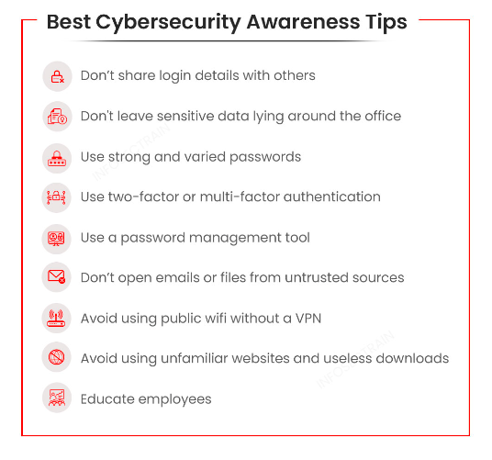

Slide 16
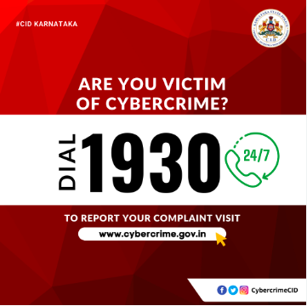
MITIGATING THE EMERGING THREATS
Multi-factor authentication (MFA):
Identity and access management:
Strong password management:
Protective Tools:
Update and Backup:
BE CAREFUL ON WHAT YOU CLICK ON:
Business E-mail Compromise (sunny@xyz.com)

Slide 17
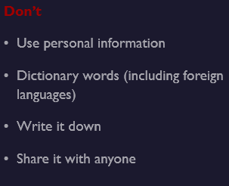
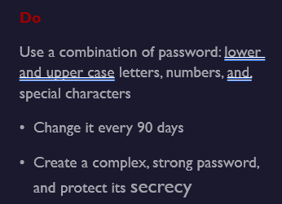
Password Policy
Passwords must be:
Obscured during login and during transmission.
Changed after the initial login.
Forced by the system to be changed every 90 days.
Strong - shall include three of the four characteristics:
Numerals
Alphabetic characters
Upper and lower case letters
Special characters
Passwords shall be at least eight (8) characters in length.

Slide 18
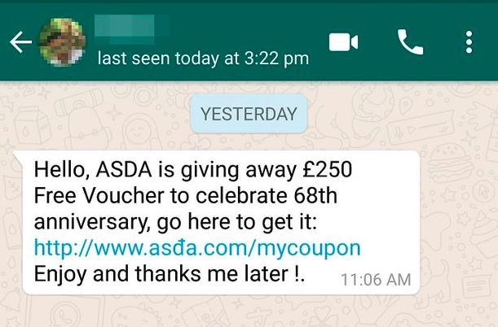
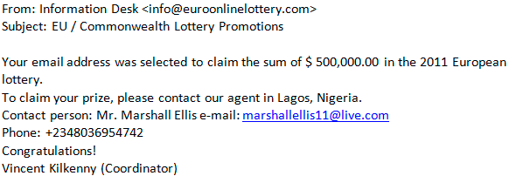
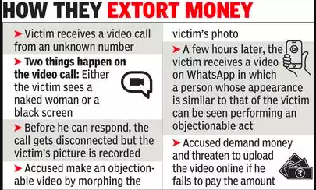
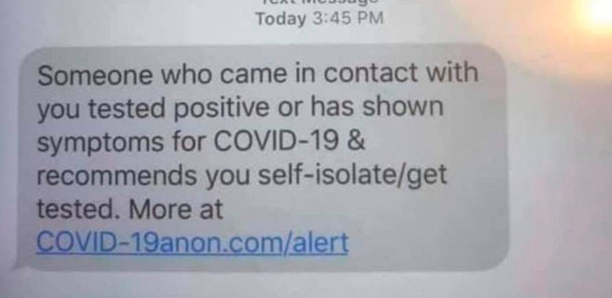

Slide 19
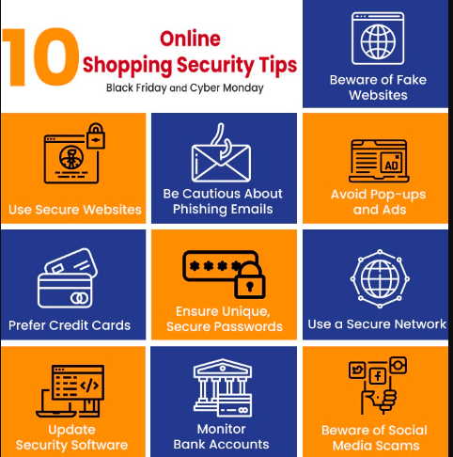
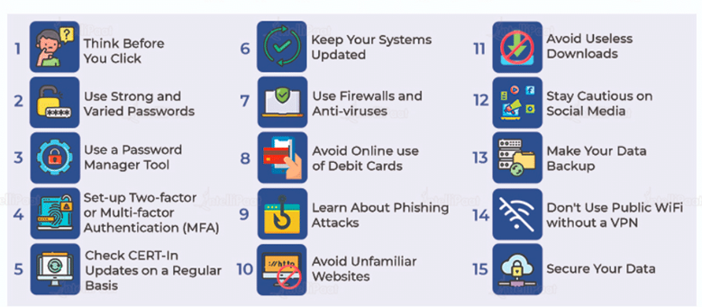

Slide 20
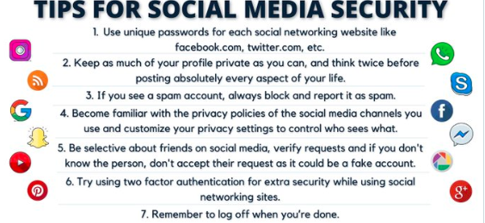

Slide 21
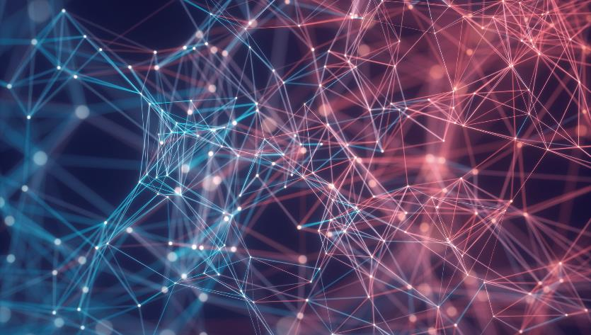
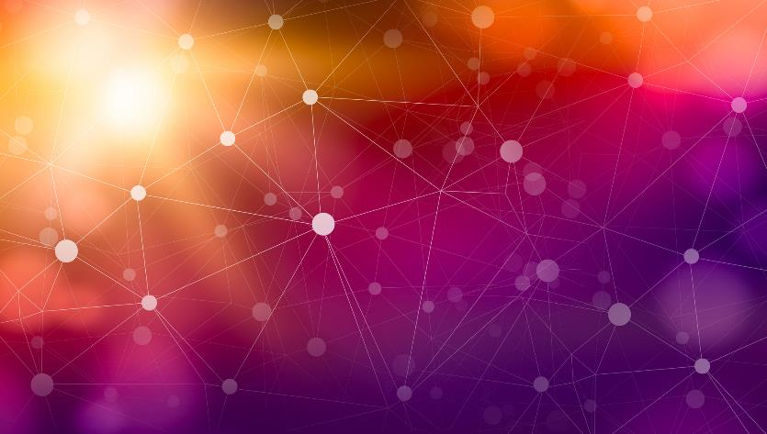
Thank You Keep Surfing and stay safe
Shiv Kumar
shiv@amtexsystems.com

